Slide 1
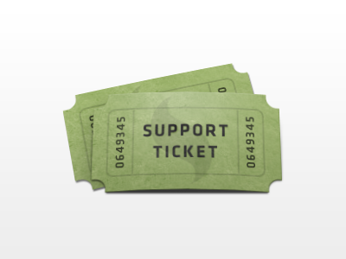
Clinical Breakout Session – FAQ Breakout Session
Support Ticket Recap Rundown
Jasmine Johnson

Slide 2
LET’S PLAY JEOPARDY!
User Roles and Permissions
Scheduler
Custom Forms
E-Superbill
Immunization
Provider Notes
https://jeopardylabs.com/play/faq-frenzy-3

Slide 3
Look Who Has Extra Time…

Slide 4
E-superbill/Provider Notes Continued
Question
Answer
Can we add an addendum to the e-Superbill?
Yes!
From the provider note, select “Edit eSuperbill” and then select the “Append” icon and then select “Append”

Slide 5
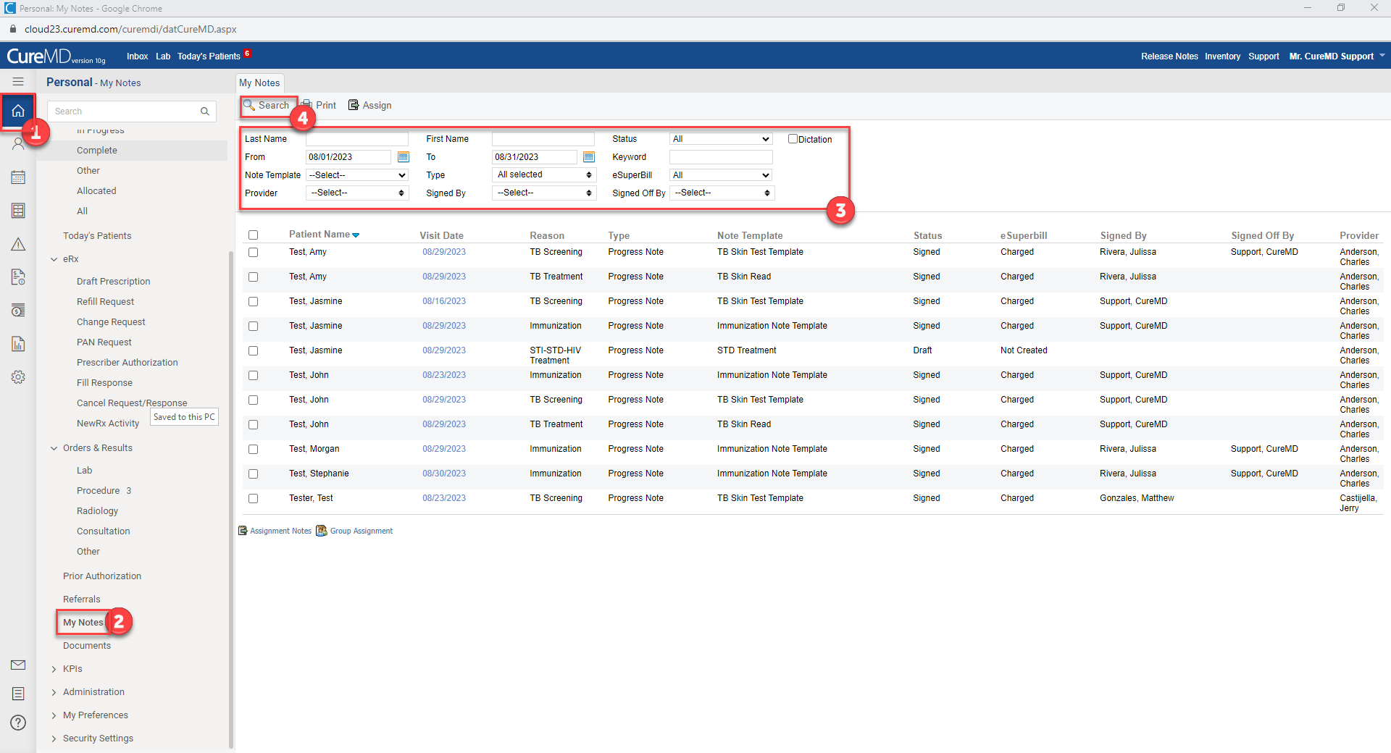
E-superbill/Provider Notes Continued
Question
Answer
How can another MD view a Provider Note?
By viewing all provider notes from the personal module. This can also be set as a quick link. Note: Permissions may need to be set to allow this

Slide 6
Q&A

